Slide 1
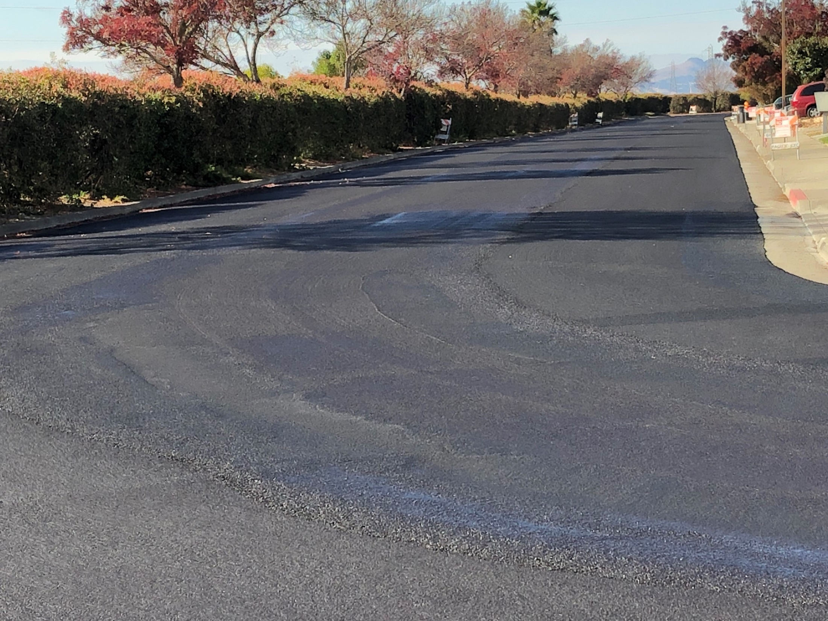
Senate Bill 1 (SB 1) Funding: 2018-2020 Progress Report
Presented to the
STA Board on July 8, 2020

Slide 2
Background on SB 1
The Road Repair and Accountability Act of 2017, commonly referred to as Senate Bill (SB) 1, was signed into law on April 28, 2017
The act mandates an investment of $54 B over 10 years in transportation infrastructure repair, as well as transit and road safety improvements (including bicyclist and pedestrian projects)
These revenues are generated through an increase in state gas tax and vehicle registration fees. Senate Bill 1 (SB 1) will allocate approximately $26 B to cities and counties and $26 B to the state highway system over 10 years.
On June 5, 2018 California voters passed Proposition 69, which mandated that funds generated by SB 1 be spent only on transportation projects. In November 2018, voters rejected Proposition 6, which would have repealed SB 1.

Slide 3
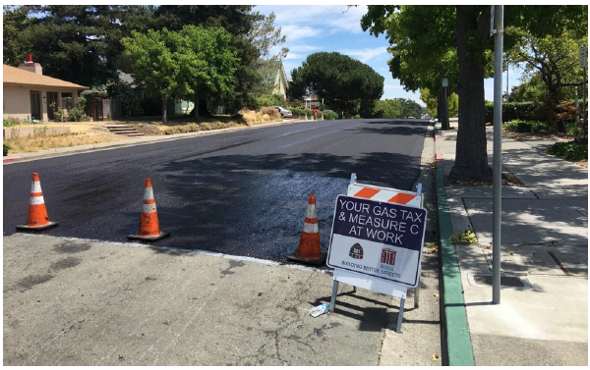
City of Benicia
By the end of FY 19-20, the City of Benicia will have received approximately $1.1 M in SB 1 funding since FY 17-18. The City has used this funding in combination with Measure C funds to expand their street repair program. By the end of 2020, the City of Benicia will have completed 65 road repair projects.

Slide 4
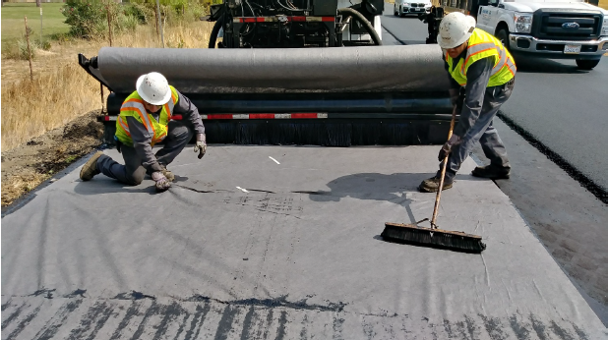
Solano County
By the end of FY 19-20, Solano County will have received approximately $16.8M in SB 1 funding since FY 17-18. The County has used this funding to match local, state, and federal funds to deliver $35 million in road maintenance, improvement, and rehabilitation projects.

Slide 5
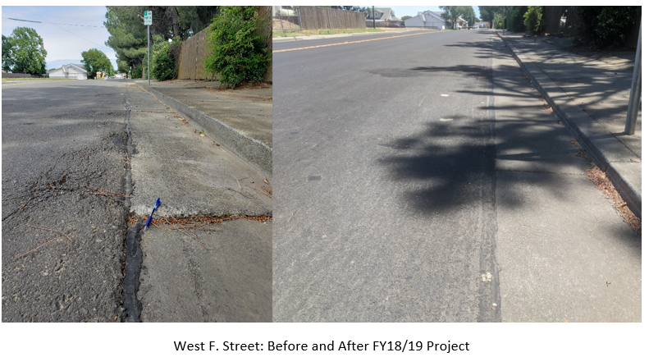
City of Dixon
By the end of FY 19-20, the City of Dixon will have received approximately $807,618 in SB 1 funding since FY 17-18. The City has used this funding to support:
2018-19 Street Rehabilitation Project, which re-paved approx. 14,000 ft² of asphalt concrete and re-sealed approx. 48,000 yds² of street
2019-20 Street Rehabilitation Project, which will rehabilitate 48 streets throughout Dixon using Type II micro-surfacing
Before
After
West F. Street

Slide 6
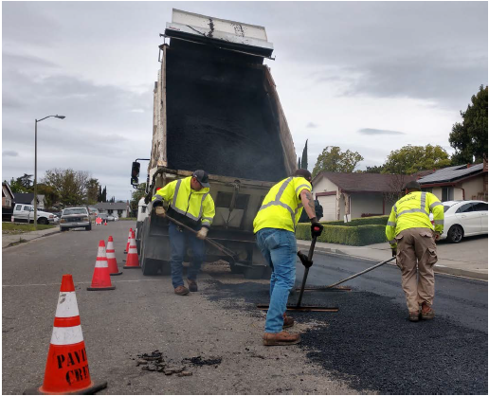
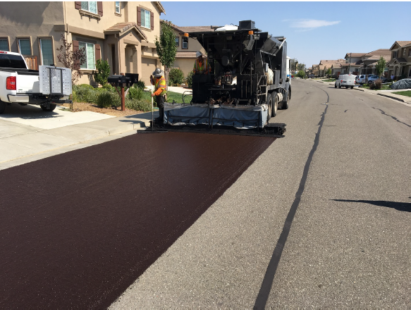
City of Fairfield
By the end of FY 19-20, the City of Fairfield will have received approximately $4.8M in SB 1 funding since FY 17-18. The City has used this funding in combination with Measure P funding to expand their street repair program and improve Business Center Drive, Suisun Valley Road, Central Way, Central Place, Pittman Road, and local streets within the Waterman Highland and Southbrook neighborhoods.

Slide 7
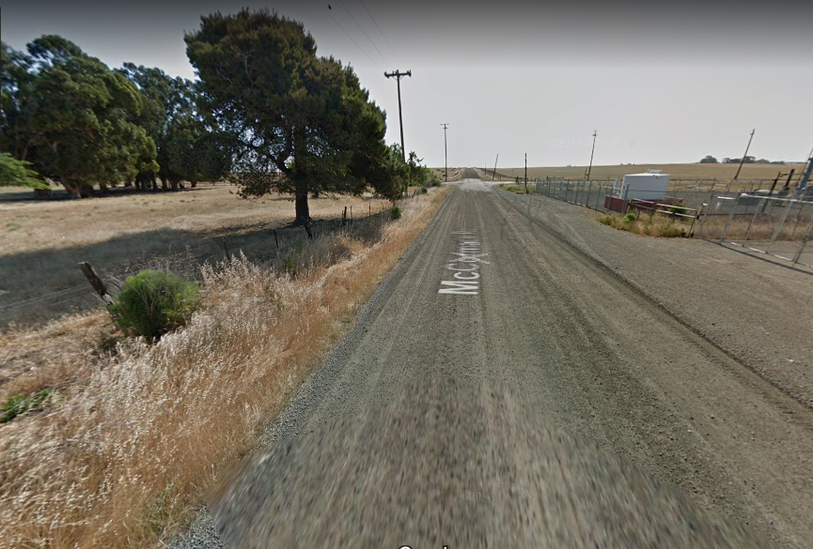
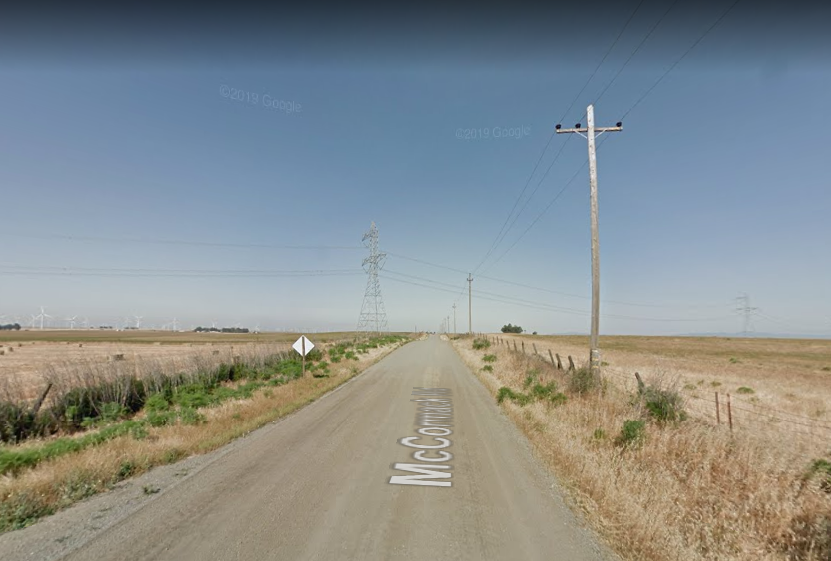
City of Rio Vista
By the end of FY 19-20, the City of Rio Vista will have received approx. $378,000 in SB 1 funding since FY 17-18. The City will use this funding and future SB 1 funding to repay the County for the McCormack Road Resurfacing Project.

Slide 8
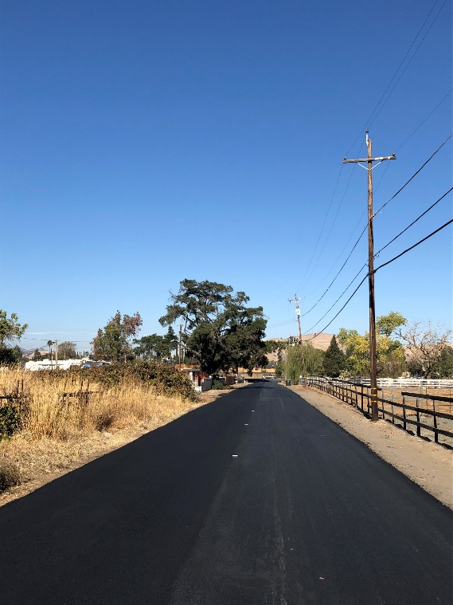
City of Suisun City
By the end of FY 19-20, Suisun City will have received approximately $1.2 M in SB 1 funding since FY 17-18. The City has used this funding to expand their street repair program:
In 2018, Suisun City repaired, reconstructed or filled potholes on 32 streets and roads totaling approx. 6 lane miles of paving and installation of 46 ADA curb ramps.
In 2019, the City paved multiple streets with over 500 tons of new asphalt placed and 2 ADA curb ramps installed.
In 2020, the City is under contract for design on 3 upcoming paving projects and has crack sealed more than 14,000 linear feet of pavement cracks on 23 streets.

Slide 9
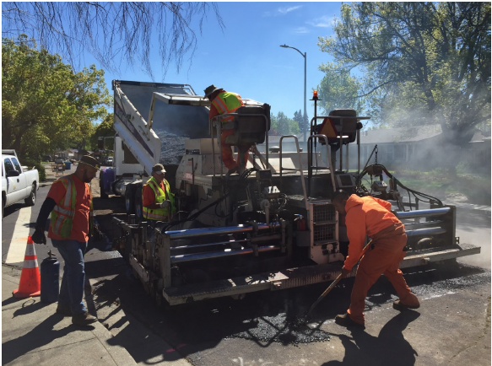
City of Vacaville
By the end of FY 19-20, the City of Vacaville will have received approximately $4 M in SB 1 funding since FY 17-18. The City has used this funding in combination with Measure M funds to expand their street repair program. $1.6M in SB 1 funding is supporting the $3.85 M 2020 Pavement Preservation Project, which will repair approximately 15 centerline miles through Slurry Seal and 10 centerline miles with Cape Seal, incorporating asphalt patch repair, crack sealing, and preventative maintenance.

Slide 10
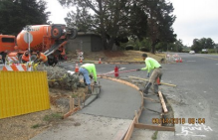
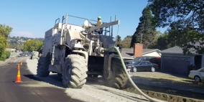
City of Vallejo
By the end of FY 19-20, the City of Vallejo will have received approximately $4.8M in SB 1 funding since FY 17-18. The City has used this funding to expand their street repair program. Notable projects include the Rollingwood Drive Paving Project and Citywide ADA-compliant Curb Ramp upgrades.

Slide 11
Questions?
Summary of SB 1 Funding
 | Jurisdiction | Total SB 1 Funding
 | Benicia | $1.1 M
 | County | $16.8 M
 | Dixon | $808 k
 | Fairfield | $4.8 M
 | Rio Vista | $378 k
 | Suisun City | $1.2 M
 | Vacaville | $4 M
 | Vallejo | $4.8 M
 | Total | $33.9 M
Please contact
Erika McLitus, Project Assistant
emclitus@sta.ca.gov

